Slide 2
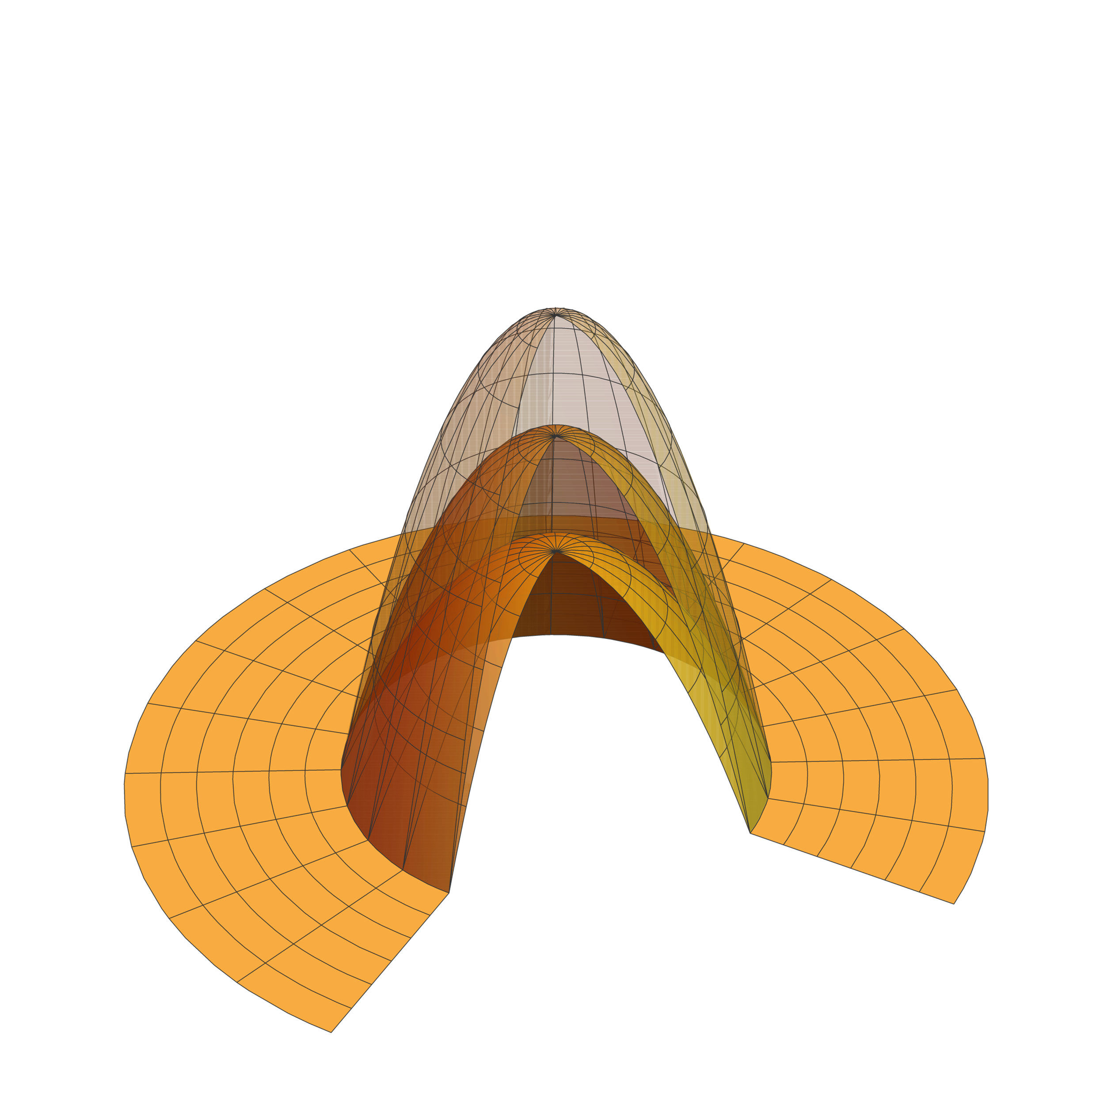
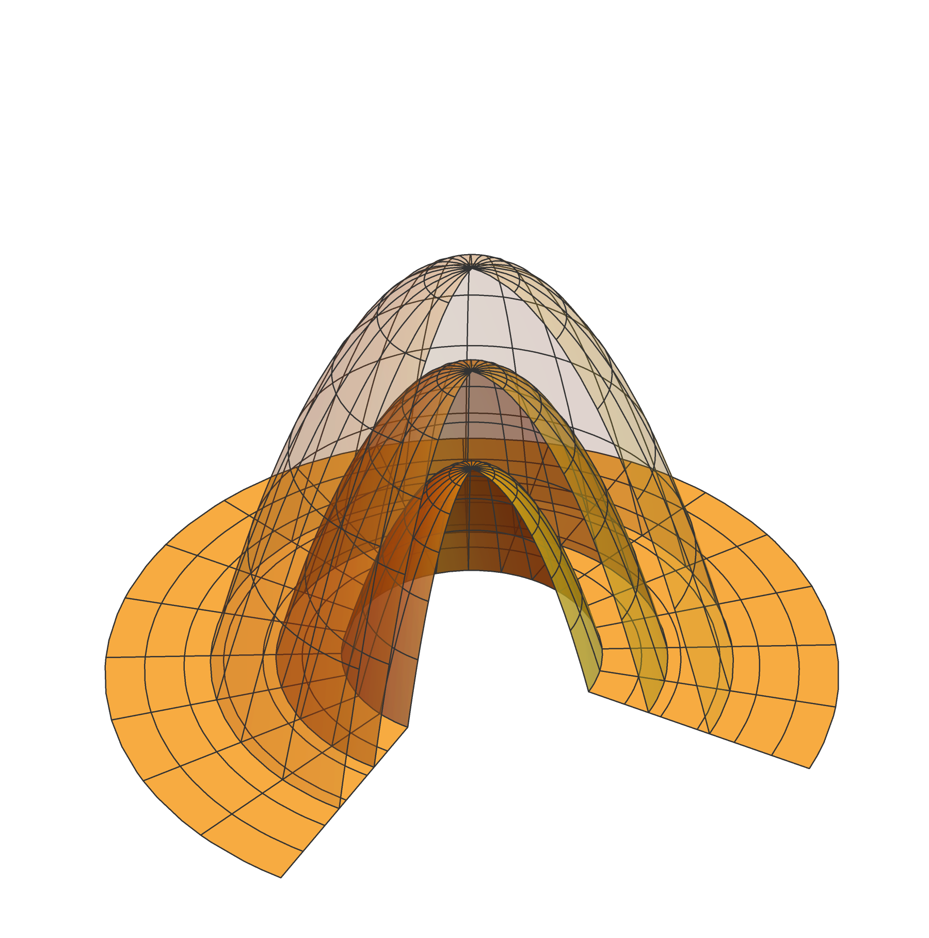
Pinned edge
Unpinned edge
Unpinned edge
Pinned edge

Slide 3
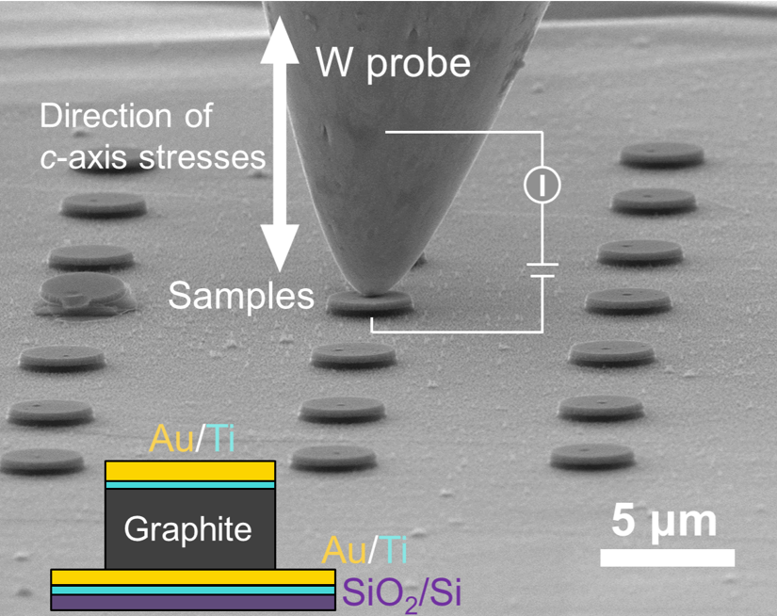
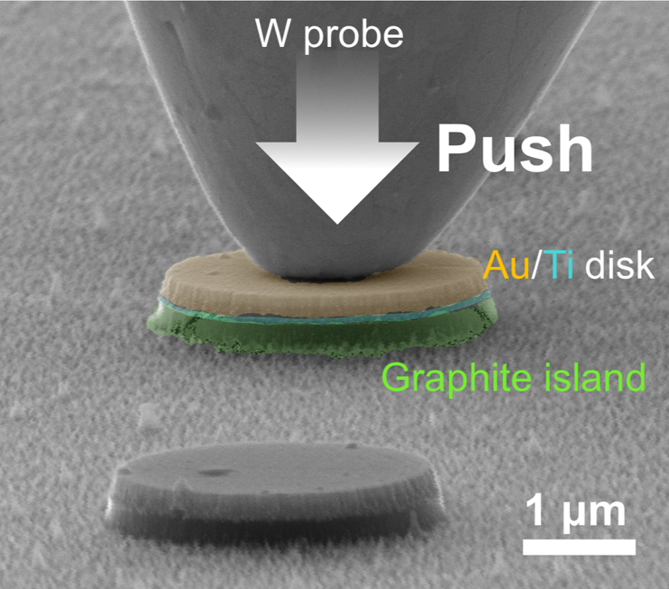

Slide 4
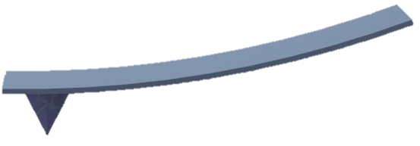
Supported 2D materials
Substrate
Macroscopic level
Suspended 2D materials
Water
Air
Substrate
IR
VIS
SFG
Microscopic level
AFM Cantilever
Substrate
Substrate
Substrate
Indentation experiment
Spectroscopy

Slide 5
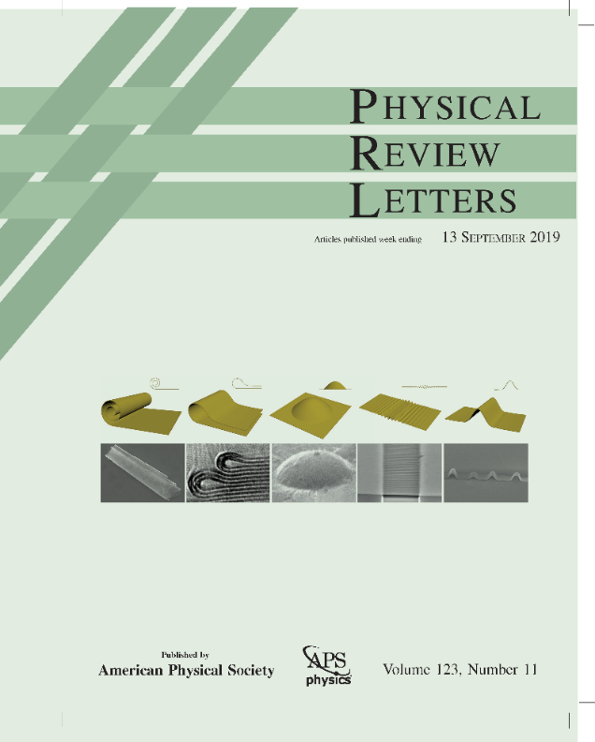
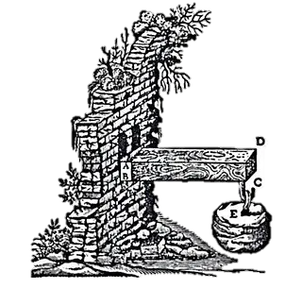
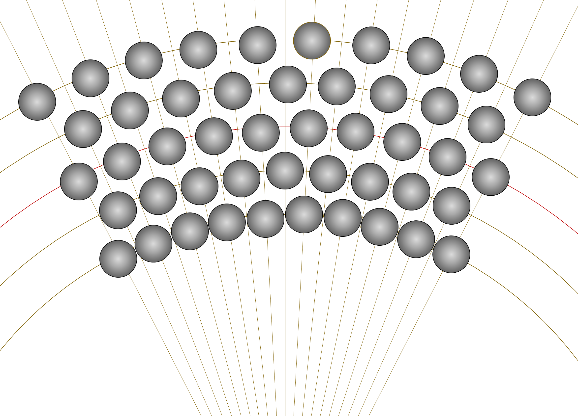

$$t$$
Galileo beam experiments
Classical beam/plate theory
How vdW materials bend?

Slide 6
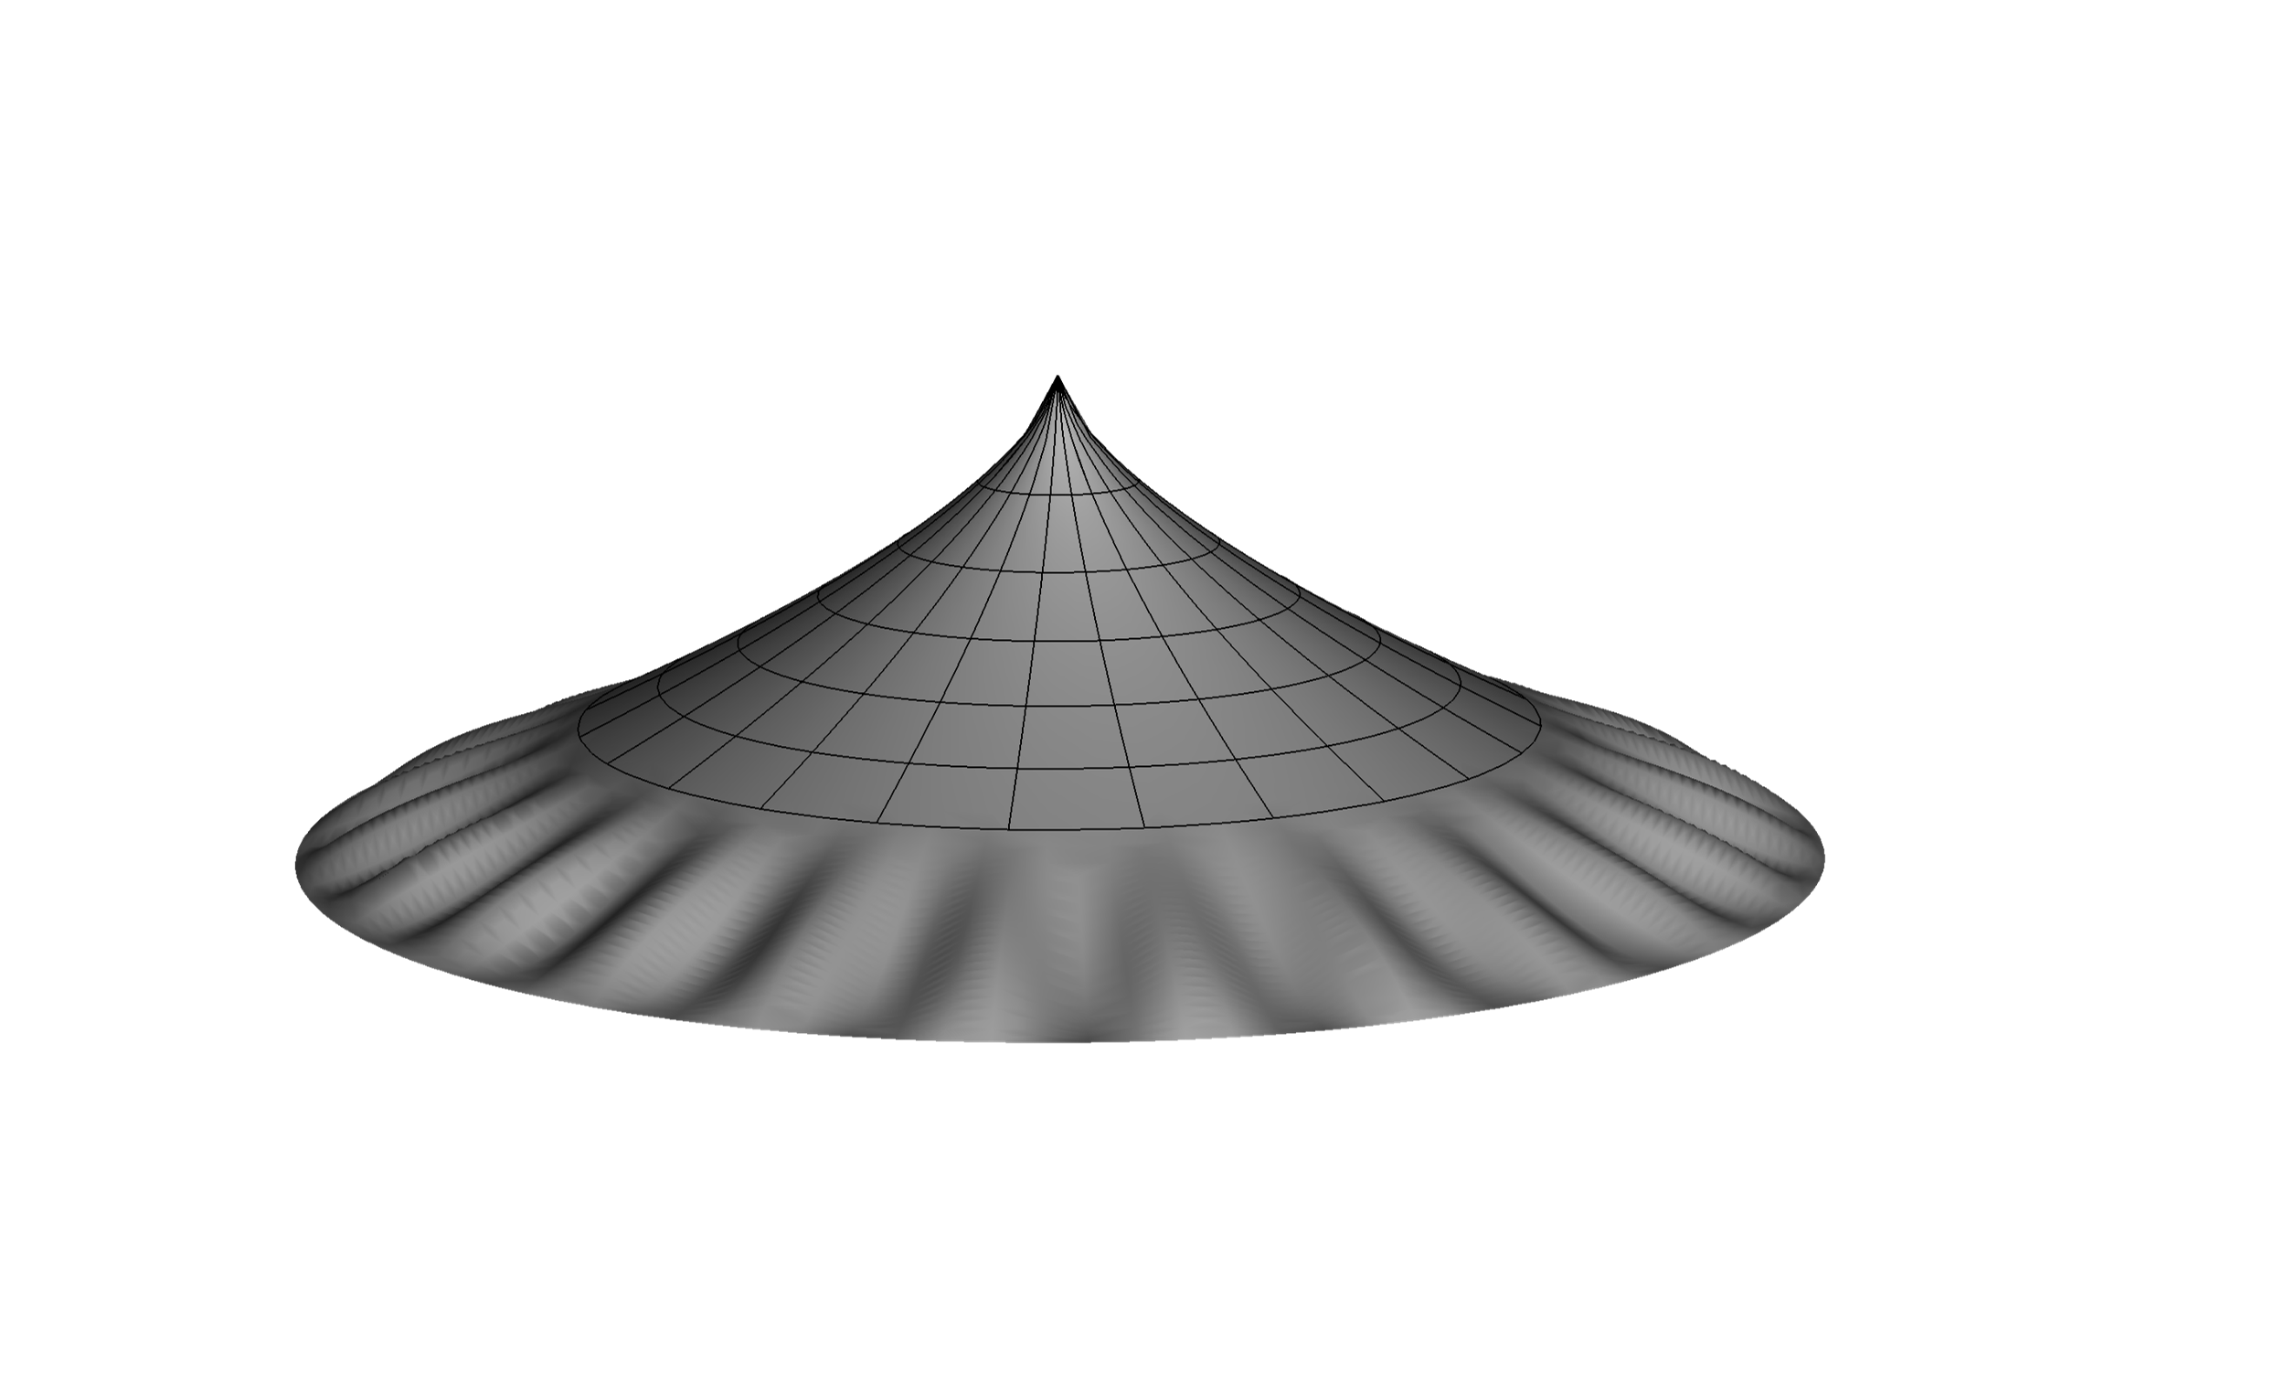
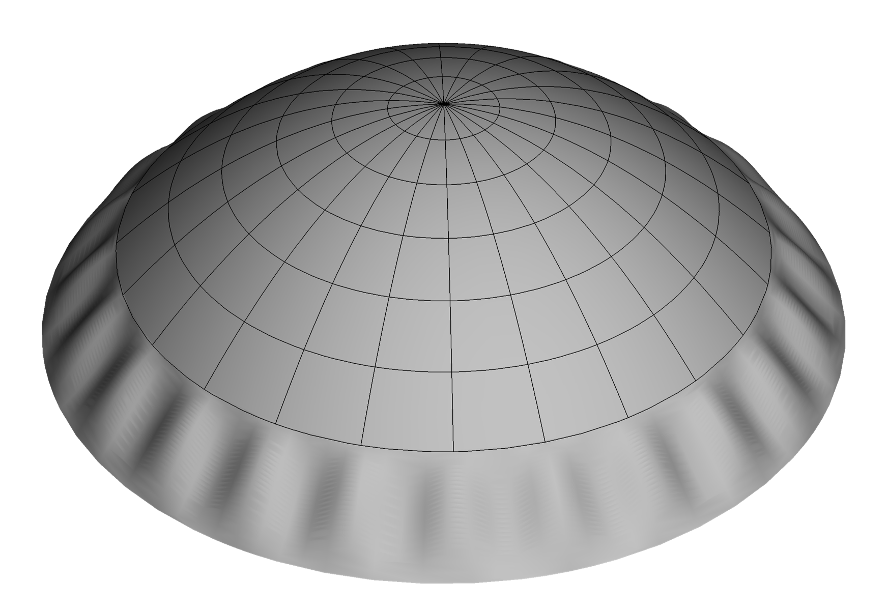

Slide 7
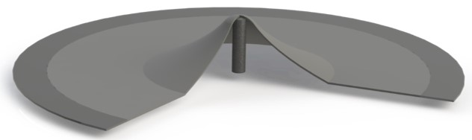
$$t_{pre}$$
$$w(r)$$
$$r$$
$$R$$
$$τ$$
$$R_{c}$$
$$R_{out}$$

Slide 8
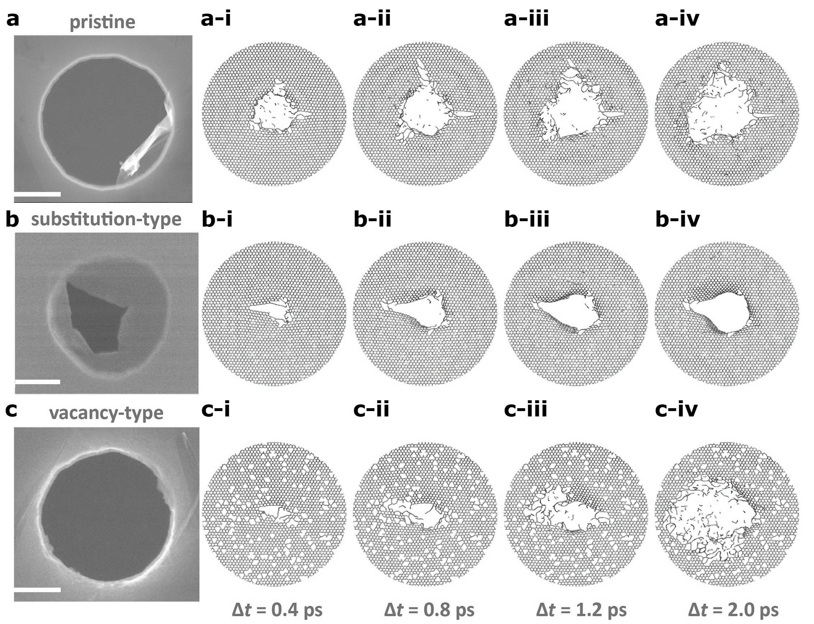

Slide 9
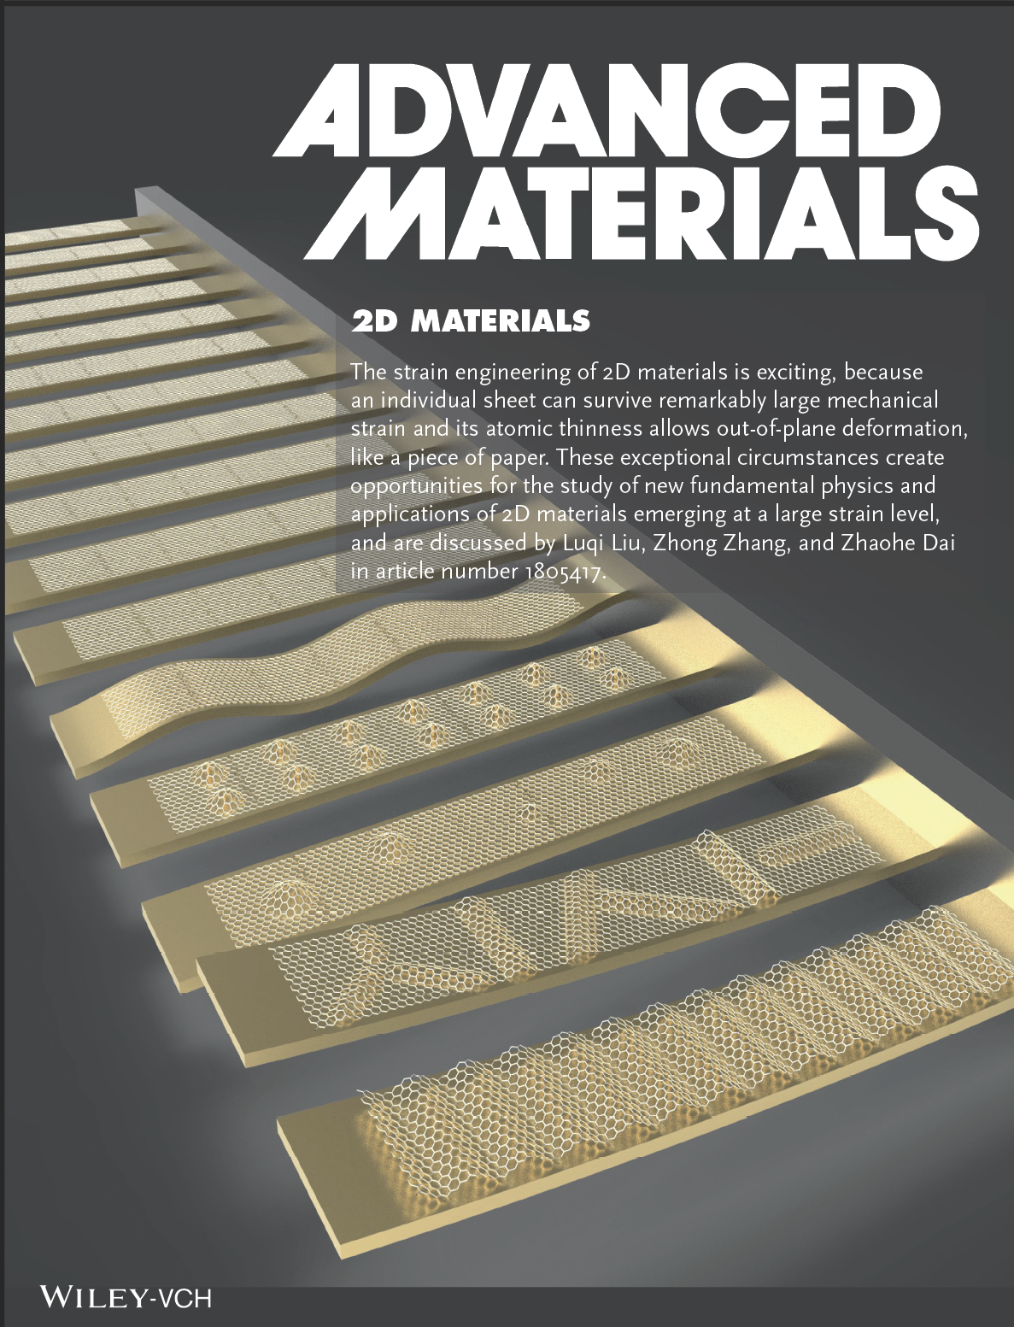
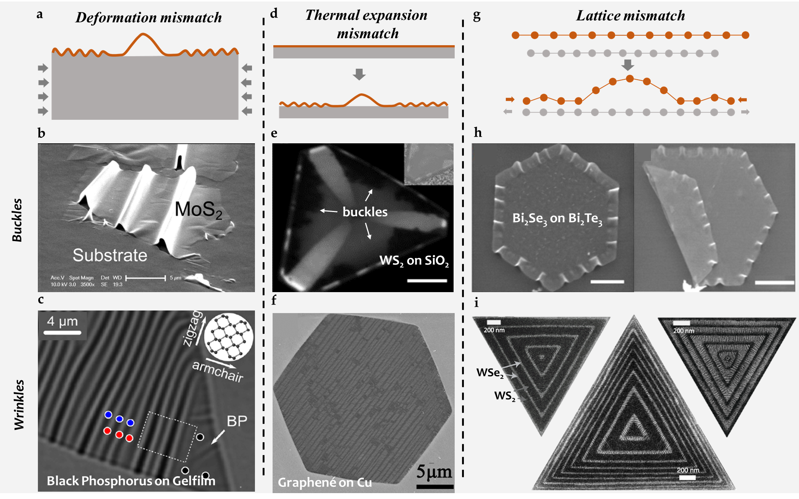

Slide 10

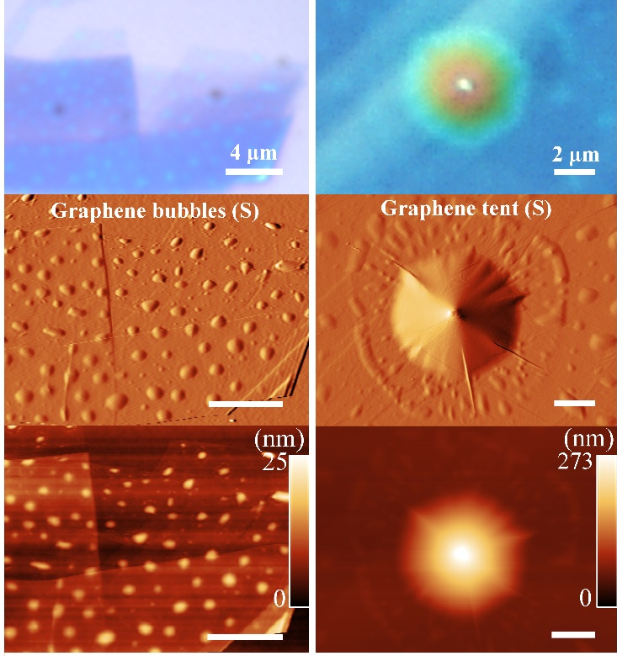

Slide 11
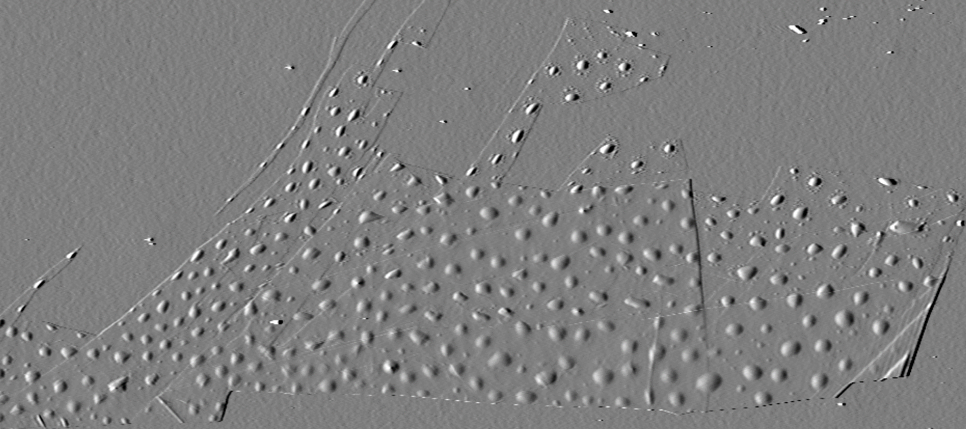
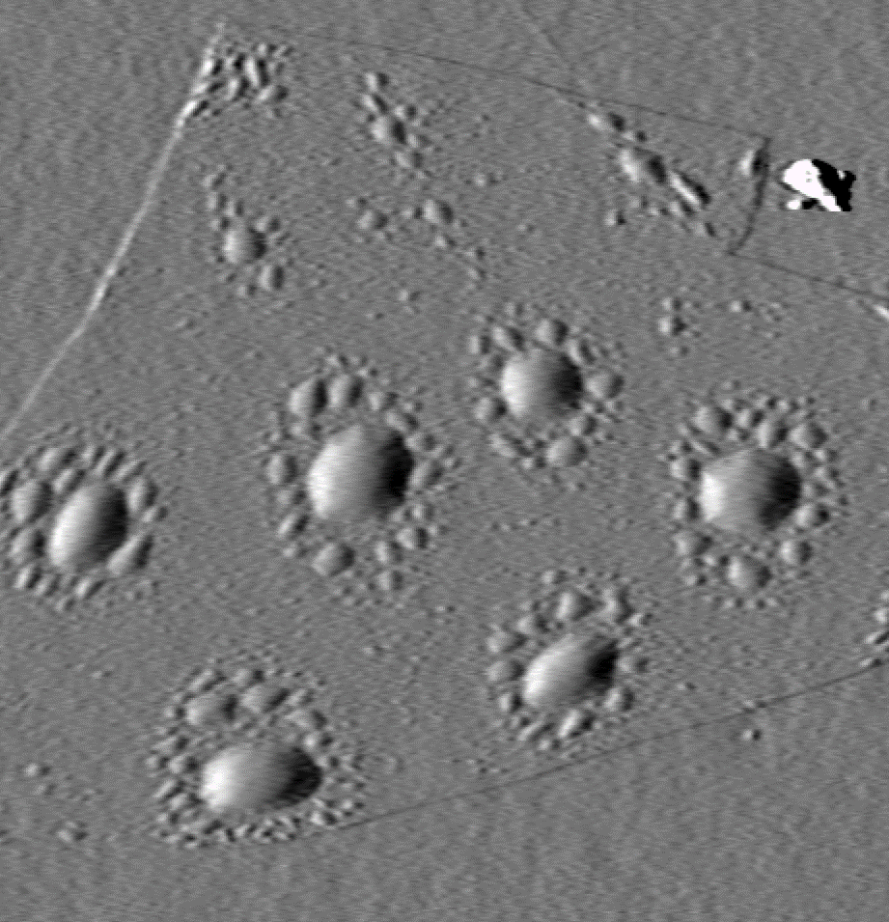
4 μm
1 μm

Slide 12
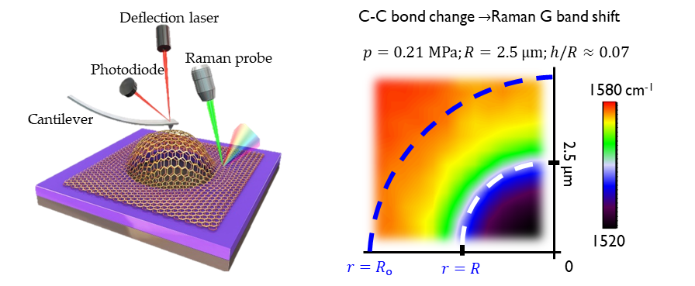

Slide 13
Sheet
Sheet
Substrate
Substrate
Elastic
Damaged
Frictional

Slide 14
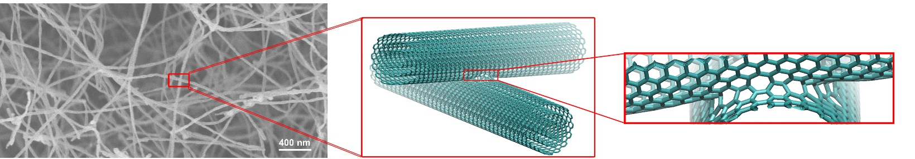

Slide 15
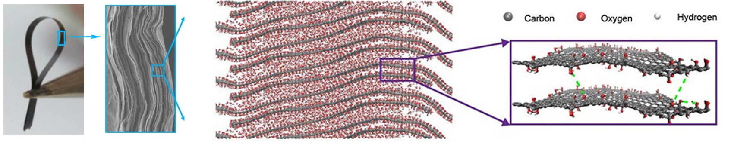

Slide 16
